Slide 1
Weekly Update
Visualization Team
Brian Zhang, Saurav Chatterjee, Zachary Stephens
Faculty Advisor: John Leonard
Sponsor: Michael Karafotis
9/30/2019

Slide 2
Goals for this Week
Verify a working model with the sponsor
Expand and solidify node map to incorporate more nodes near edge cases and base cases
Try to create a visualization (example) and incorporate randomly generated data.
Change/modify the models after meeting with sponsor.

Slide 3
Accomplishments/Challenges Encountered
Main conflict was meeting with our sponsor because of scheduling conflicts which resulted in work being delayed.
Teaching ourselves JavaScript and Cypher/Neo4J

Slide 4
Goals for Next Week
Present the Sponsor with the new models. Modify and update models according to feedback.
Complete script for generating random data sets which can be imported into a database seamlessly
Learning more about Neo4J
Try to create a model with Rapid Miner, or at least create random data.

Slide 5
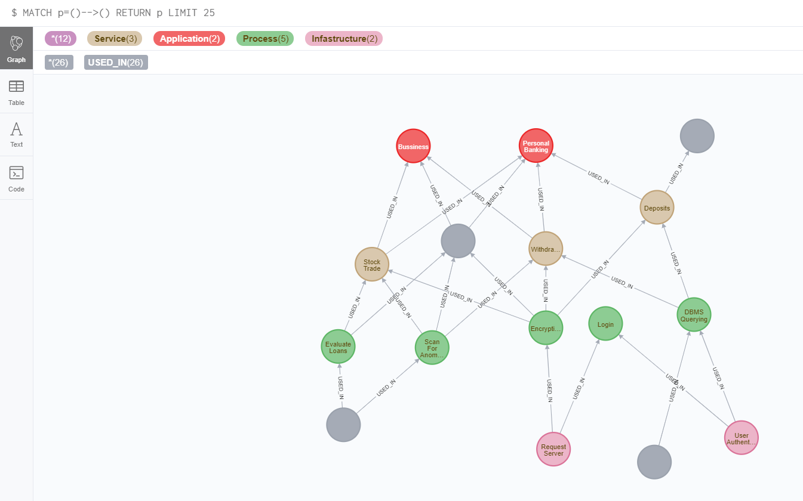
Neo4J

Slide 6
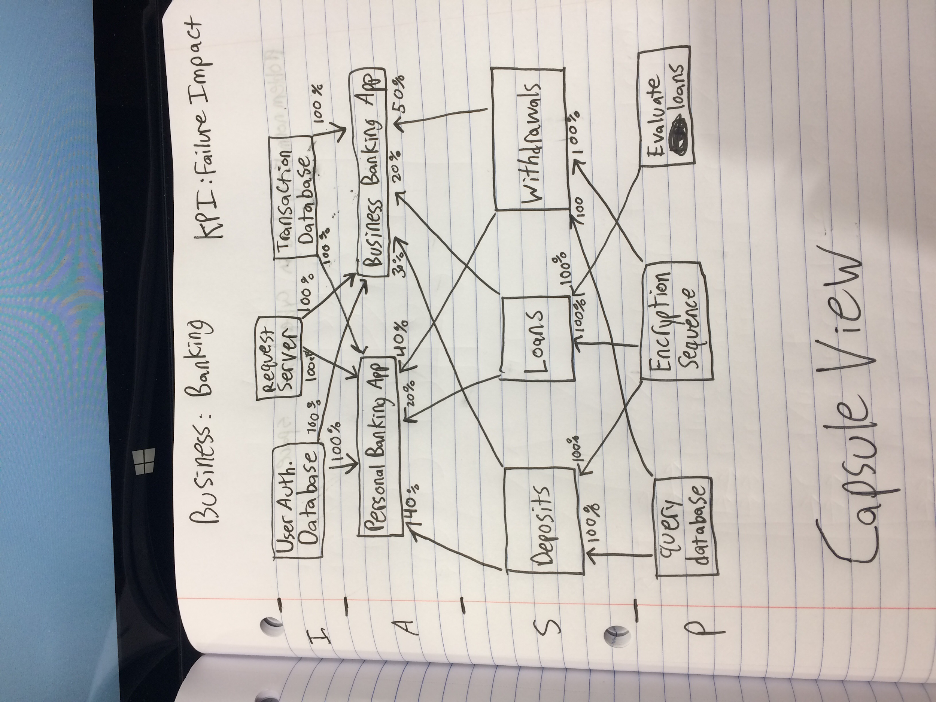
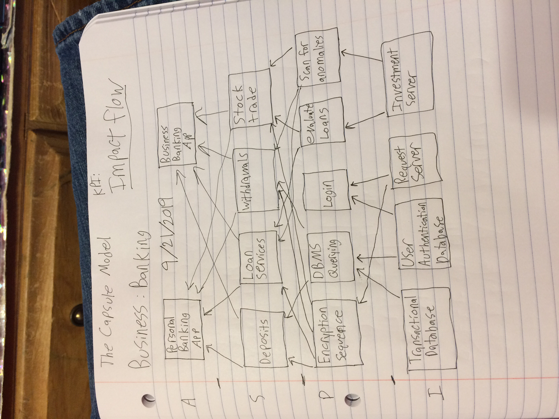
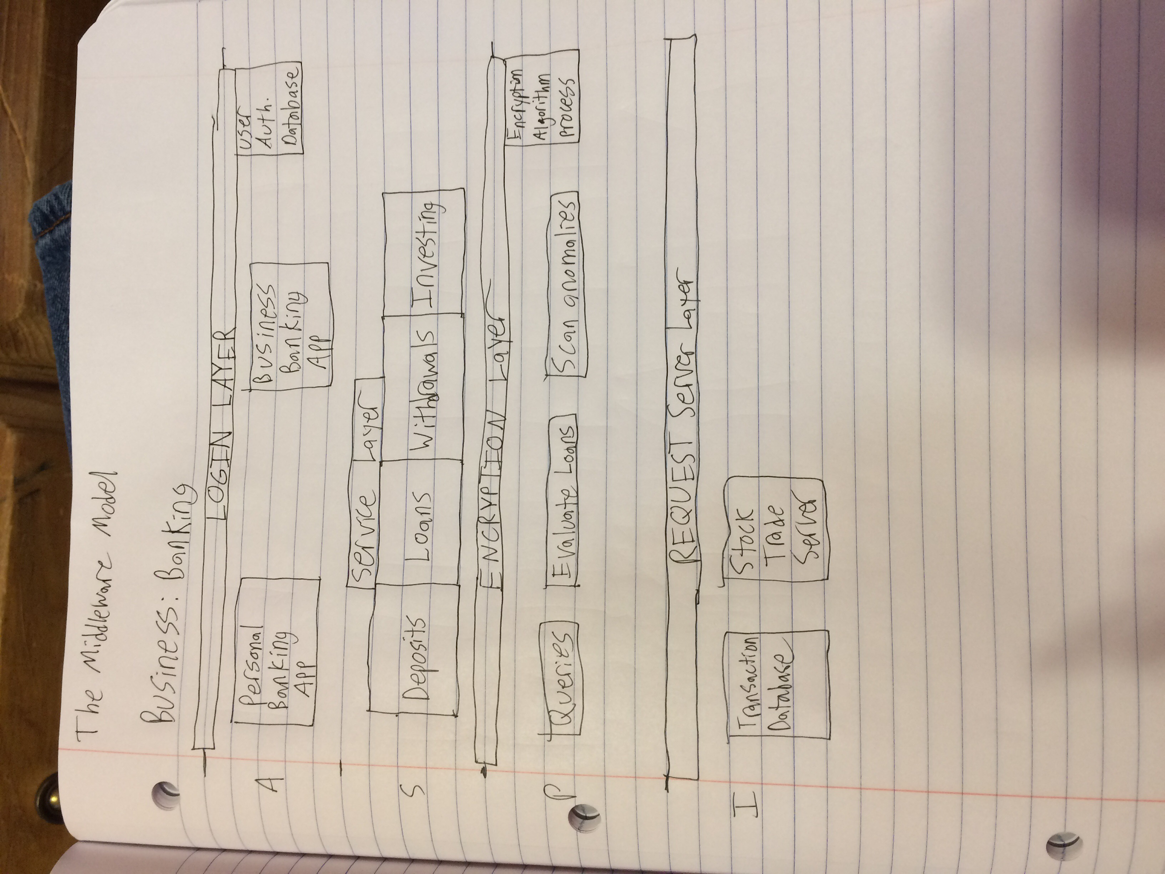
Key Results (tables, graphs, images)
Capsule Model IASP
Capsule Model ASPI
Middleware Model ASPI

